Slide 1
TensorFlow library
Data Science course

Slide 2
For download
During the classes we will use an additional file - you can download it from the "Additional materials for the block" section found here.

Slide 3
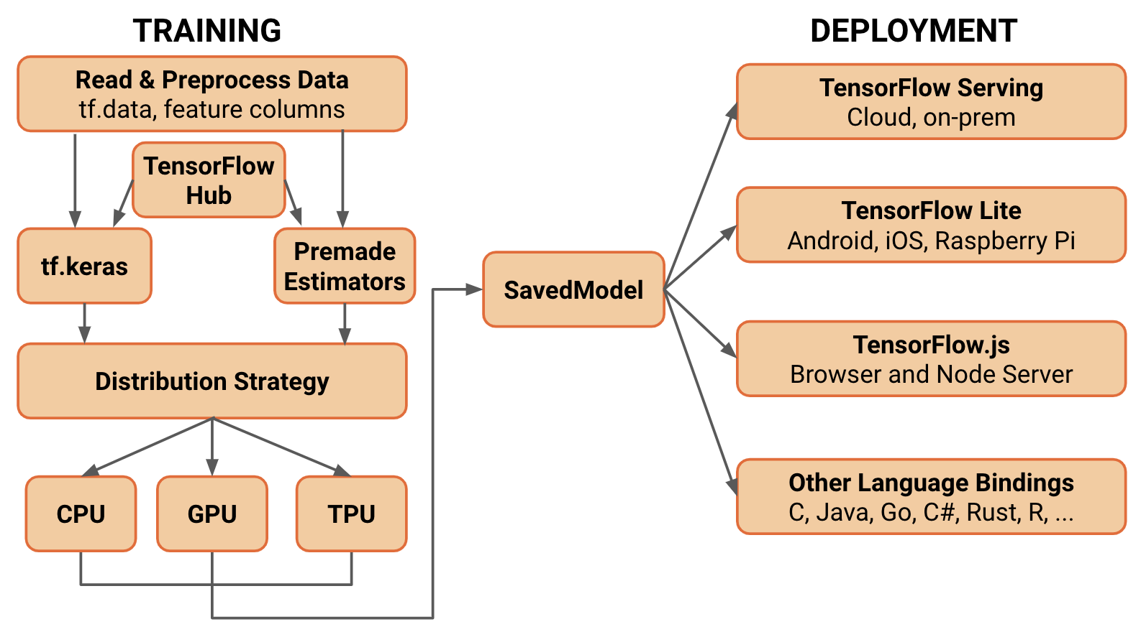

Introduction to Tensorflow
TensorFlow was designed by Google scientists and engineers to carry out research projects in the field of machine learning and deep neural networks. The system, however, remains fairly general, allowing a wide variety of other applications. In particular, TensorFlow enables optimal learning of data-intensive models (e.g. image banks).

Slide 4
Introduction to tensorflow
The flexible TensorFlow architecture enables the computation to be implemented on one or more CPUs & graphics cards (GPUs) on a personal computer or a server, etc. without having to rewrite code.
Google also created the Tensor Processing Units (aka TPU), a specialized integrated circuit designed to advance TensorFlow's machine learning and application. TPUs are designed to use and test models. They do not learn them. From February 2018 onwards, TPUs are available in the beta version of Google Cloud Platform.

Slide 5
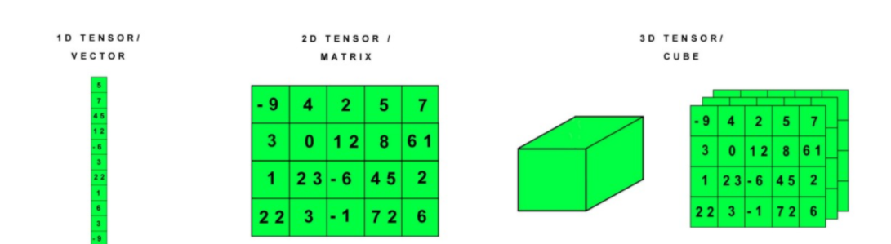
What is a tensor?
Sometimes we need arrays with more dimensions. In general, the numbers of an array form a regular grid with a variable number of axes. We call it a tensor. It is a "container" for data. We can have an 0D tensor that fits one scalar. The tensor 1D is called a vector. A 2D tensor is a matrix.

Slide 6
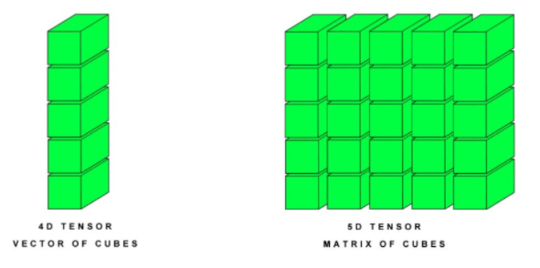
What is a tensor?
We often need to store multiple 2D tensors together. We get a 3D tensor, i.e. a cube of numbers. We can connect these cubes / cubes together to form 4D, 5D, ... ND tensors.
We denote tensors by using bold font and capital letters. For example, the tensor element A with the coordinates (i, j, k) is written as A_{i,j,k}. In machine learning, we use tensors to store various types of data, e.g. 3D tensors for time series, 4D for images, and 5D for video.

Slide 7
Getting started with tensorflow
Installation details may depend on your hardware, it is recommended to use the official tf documentation (https://www.tensorflow.org/api_docs/python/tf)
We will be using the tensorflow api for Python, so we recommend installing Anaconda as well

Slide 8
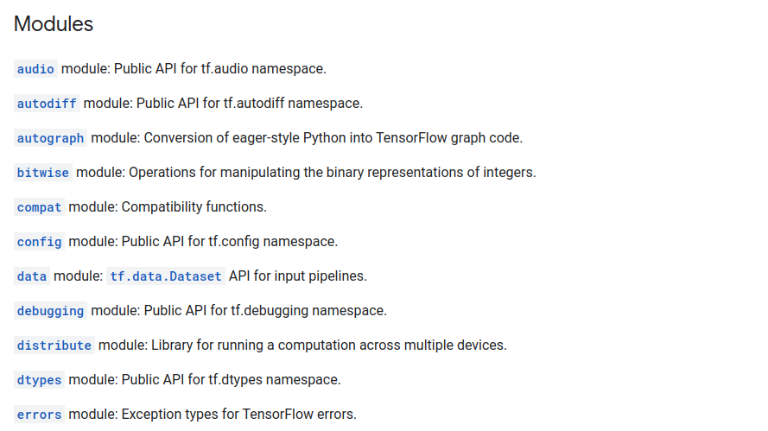
Tensorflow API
TensorFlow API are divided into modules
https://www.tensorflow.org/api_docs/python/tf

Slide 9
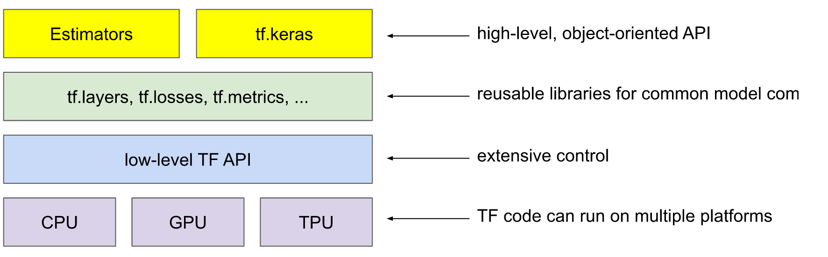
Tensorflow API

Slide 10
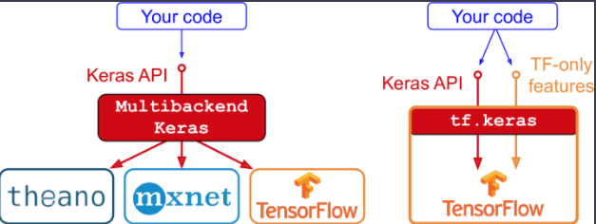
Keras and tf.keras
keres.io - reference implementation for Tensorflow
tf.keras - tensorflow implementation (subset of Tensorflow) package

Slide 11
TensorFlow Datasets
audio
nsynth
image
cifar10
diabetic_retionpathy_detection
imagenet2012
mnist
structured
titanic
text
imdb_reviews
lm1b
squad
translate
wmt_translate_ende
wmt_translate_enfr
video
bair_robot_pushing_small
moving_mnist
starcraft_video
More tensorflow.org/datasets

Slide 12
Data types in Tensorflow api
Data types of Python API in Tensorflow | Description
tf.float16 | 16-bit floating point number (half precision)
tf.float32 | 32-bit floating point number (single precision)
tf.float64 | 64-bit floating point number (double precision)
tf.int8 | 8-bit integer number (with sign)
tf.int16 | 16-bit integer number (with sign)
tf.int32 | 32-bit integer number (with sign)
tf.int64 | 64-bit integer number (with sign)
https://www.tensorflow.org/api_docs/python/tf/dtypes

Slide 13
tf.Tensor
Represents a multidimensional array of elements, all elements are of a single known data type. tf.Tensor is immutable.
Properties:
single data type
- shape
In eager execution operations are evaluated immediately
Specialized tensors are available:
tf.Variable
tf.constant
tf.sparse.SparseTensor
tf.RaggedTensor
tensorflow.python.framework.ops - source code

Slide 14
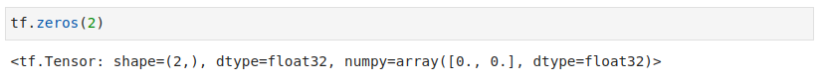
Initialization of fixed tensors
So far we have discussed tensors as abstract mathematical entities. However, a system like TensorFlow has to run on a real computer, so each tensor has to function in the computer's memory to be useful to programmers. TensorFlow provides a series of functions that initialize the basic tensors in memory. The simplest ones are tf.zeros () and tf.ones (). tf.zeros () takes the shape of a tensor (represented as a Python tuple) and returns a tensor of that shape, filled with zeros.
Create a tensor with zero elements:

Slide 15
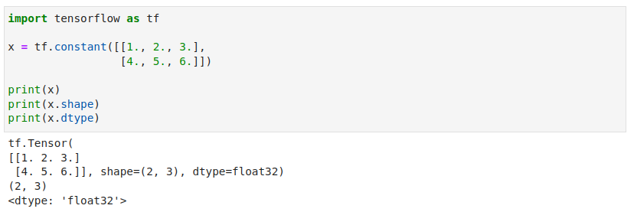
tf.Tensor - standard operations
tensorflow.python.framework.ops - soruce code

Slide 16
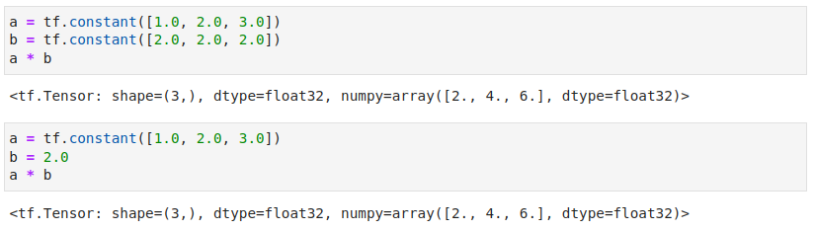
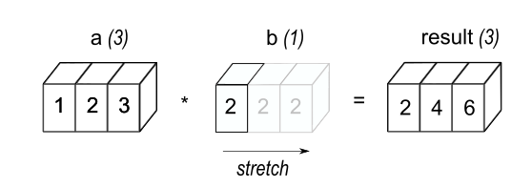
Broadcasting
This concept is borrowed from equivalent feature in NumPy

Slide 17
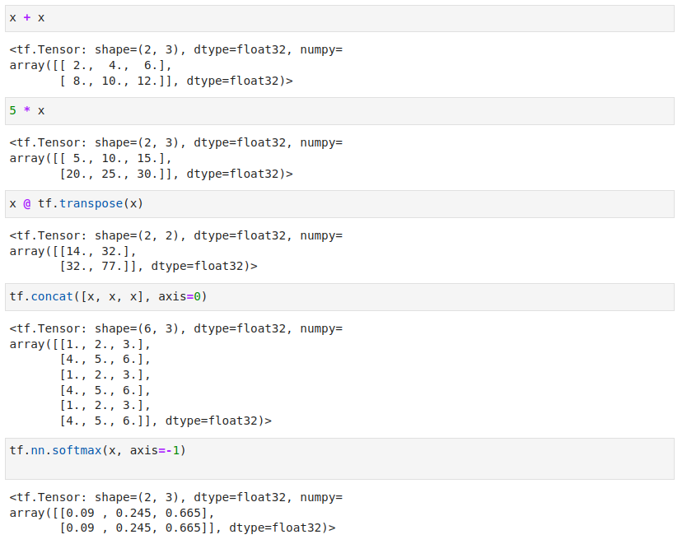

Slide 18
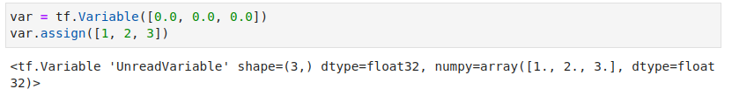
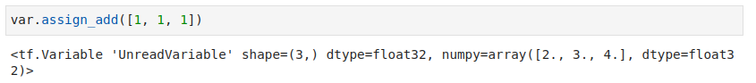
tf.Variable
tf.Tensor objects are immutable. To store model weights or other mutable data in TensorFlow we can use tf.Variable
tensorflow.python.framework.ops - soruce code

Slide 19
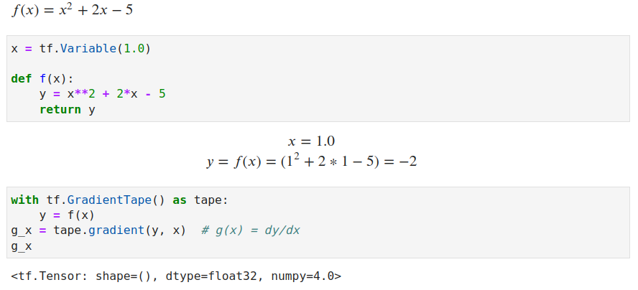
Automatic differentiation
Tensorflow implements automatic differentiation (autodiff), which uses calculus to compute gradients.

Slide 20
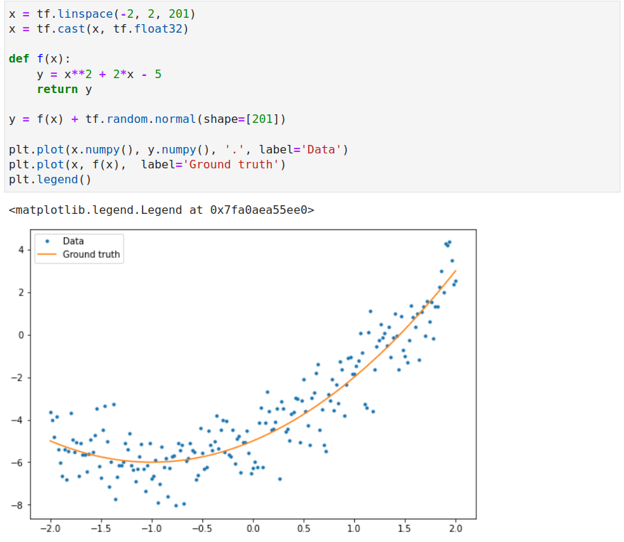
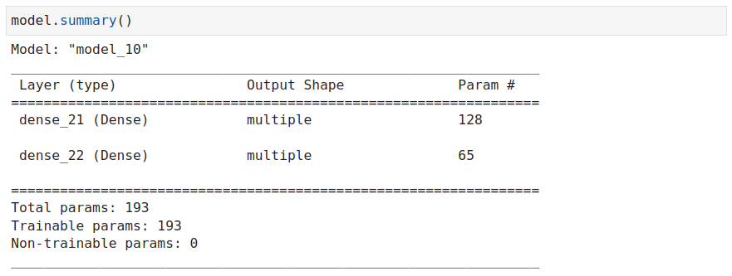
Training loops

Slide 21
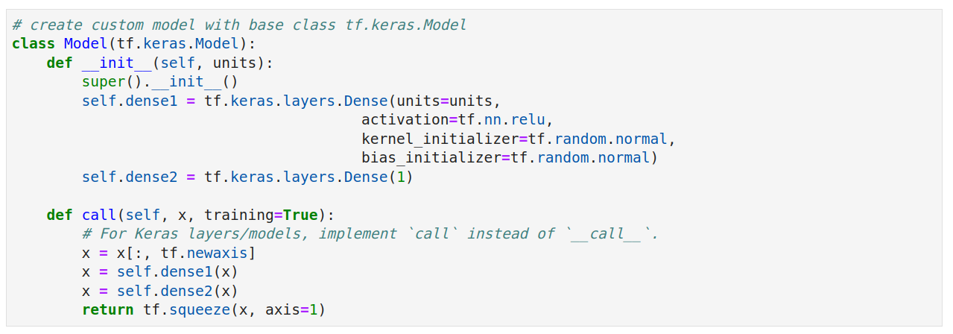
Create custom linear model

Slide 22
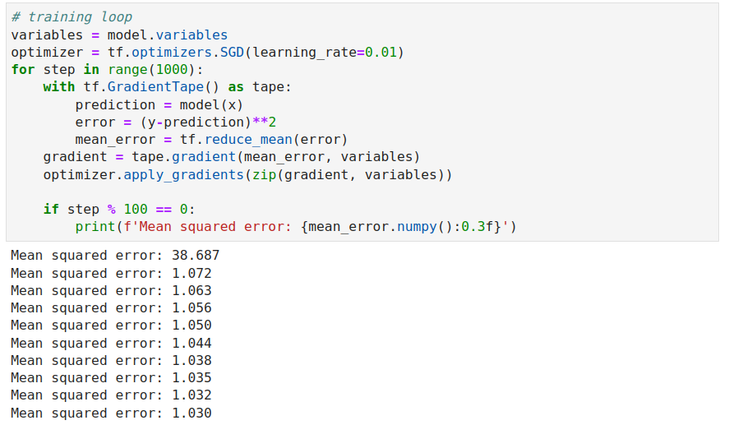
Basic training loop

Slide 23
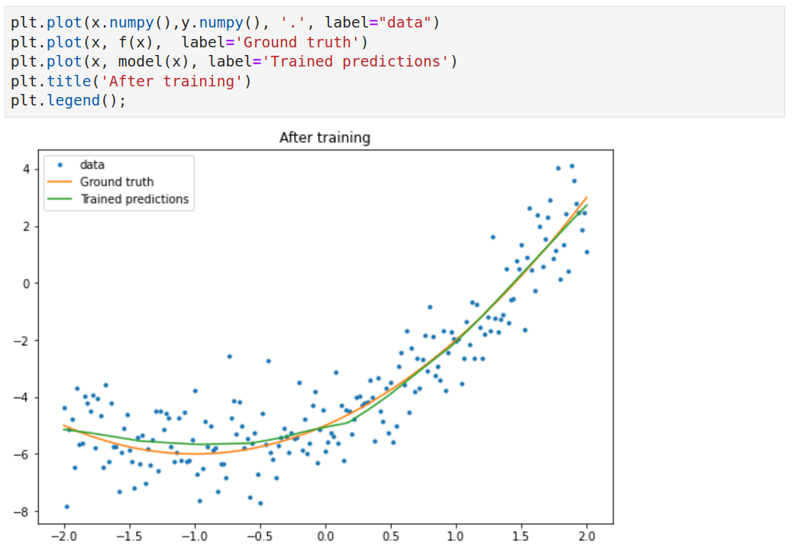

Slide 24
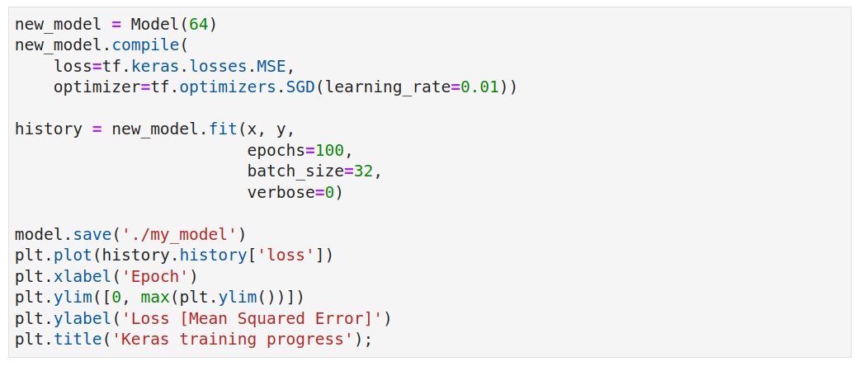
With tf.keras

Slide 25
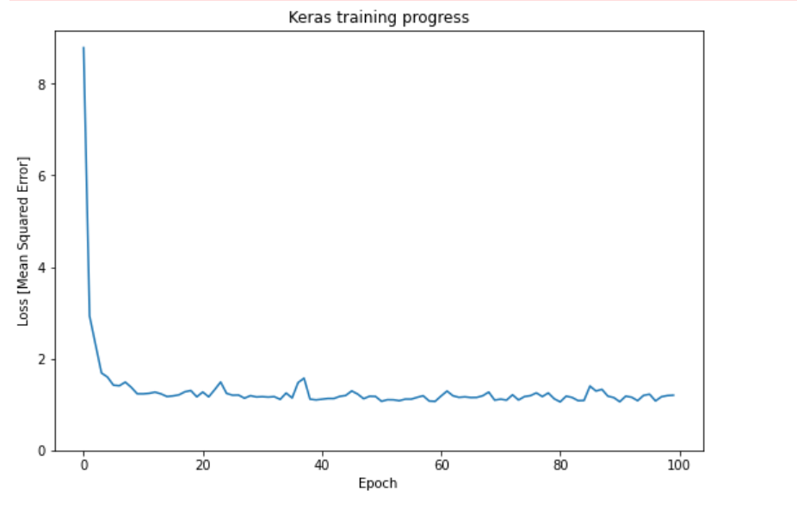
With tf.keras

Slide 26
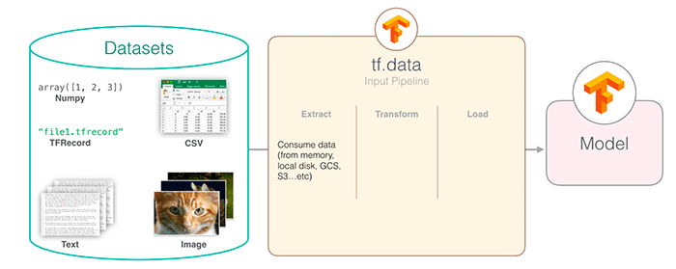
tf.data - pipelines
tf.data is new API introduced in Tensorflow 2, it enables to build complex input pipelines from simple pieces.
tf.data.Dataset abstraction that represents a sequence of elements

Slide 27
tf.data - Reading input data
tf.data can read input from different sources
NumPy arrays
Python generators
TFRecord
Text data
CSV data
Sets of files

Slide 28
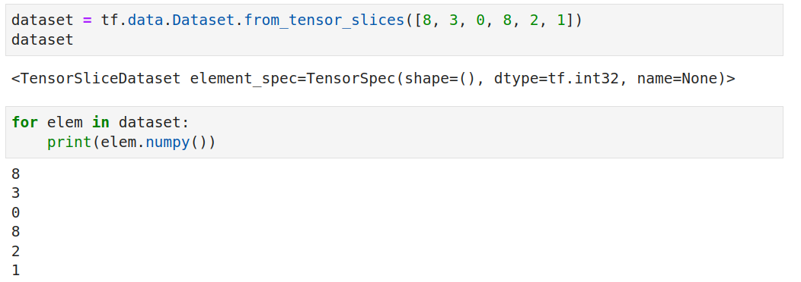
tf.data - input pipelines

Slide 29
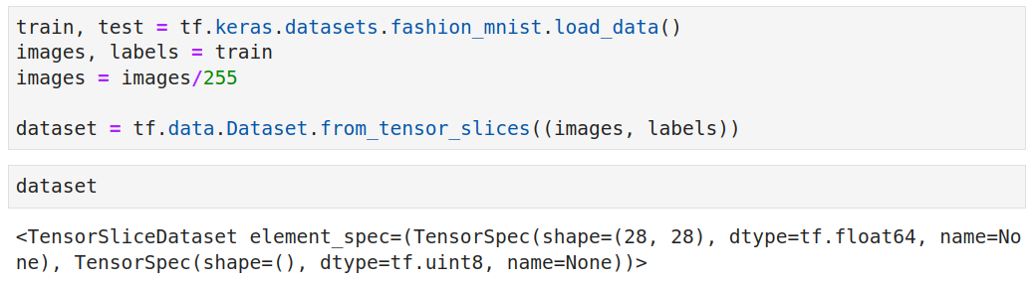
tf.data - NumPy Arrays

Slide 30
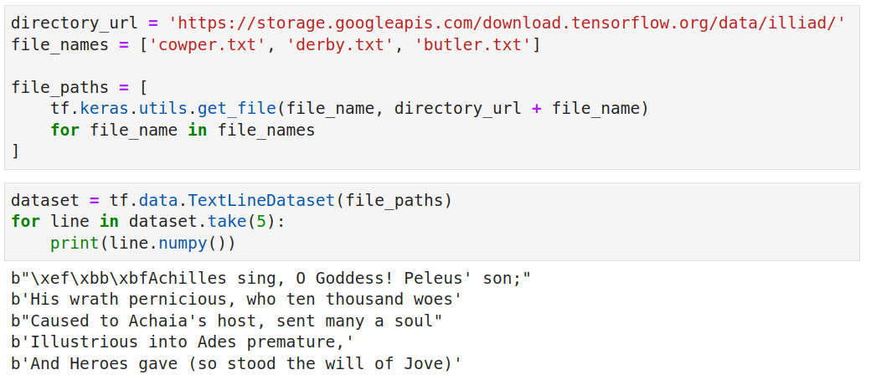
tf.data - text data

Slide 31
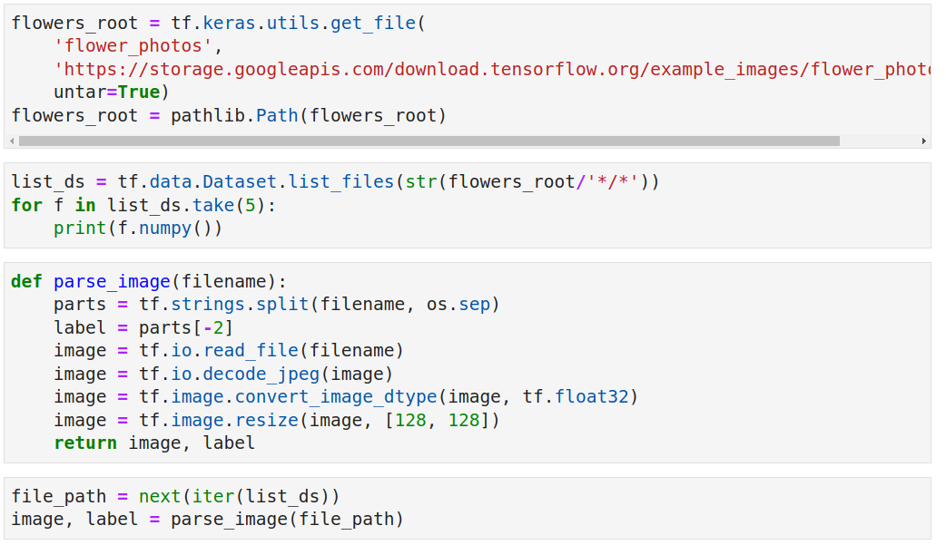
tf.data - preprocessing data

Slide 32
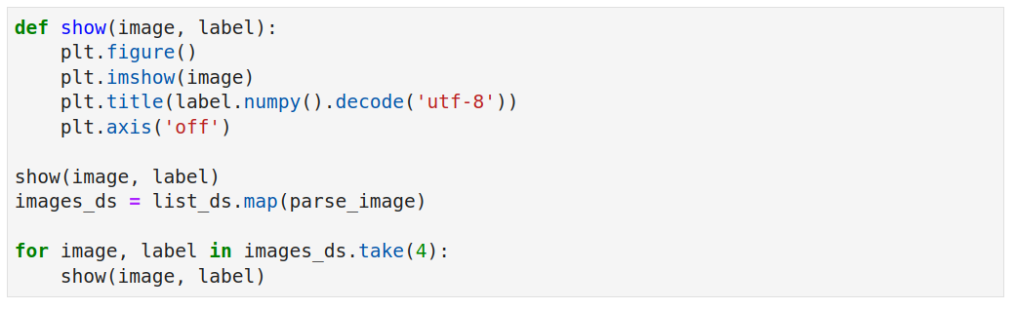
tf.data - preprocessing data

Slide 33
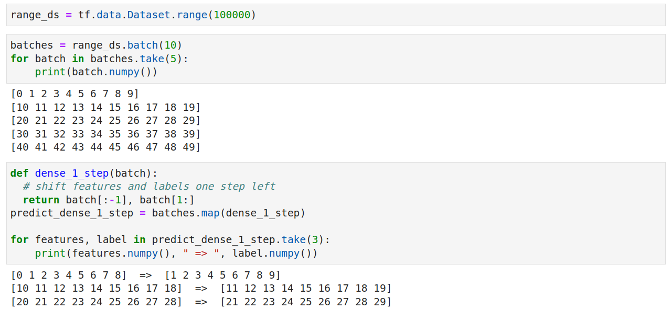
tf.data - time series windowing

Slide 34
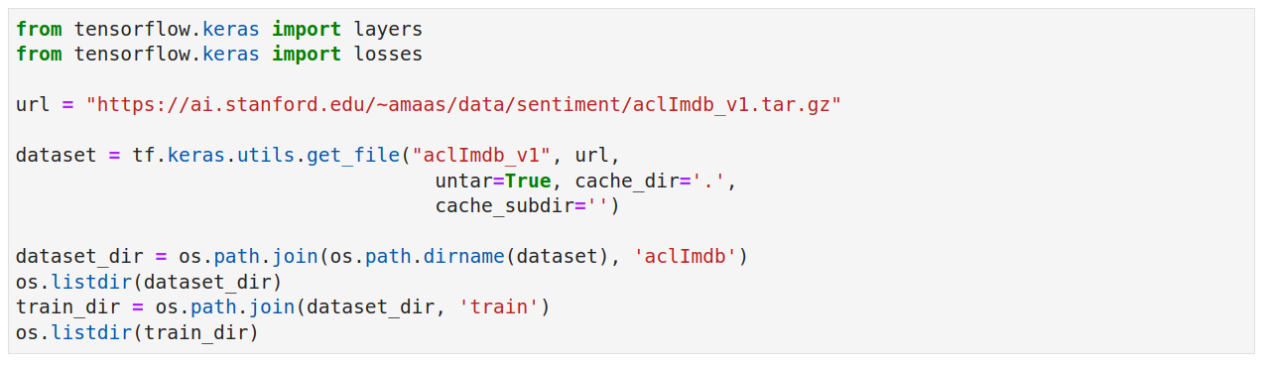
Text Vectorization

Slide 35
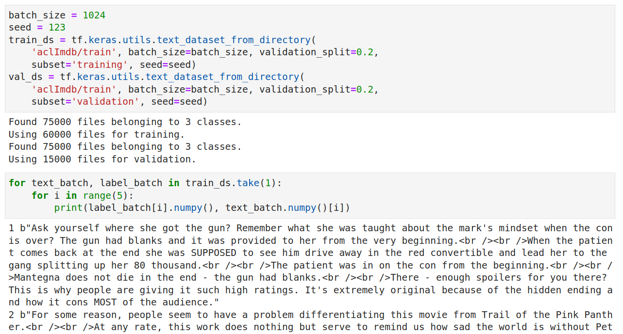
Text Vectorization

Slide 36
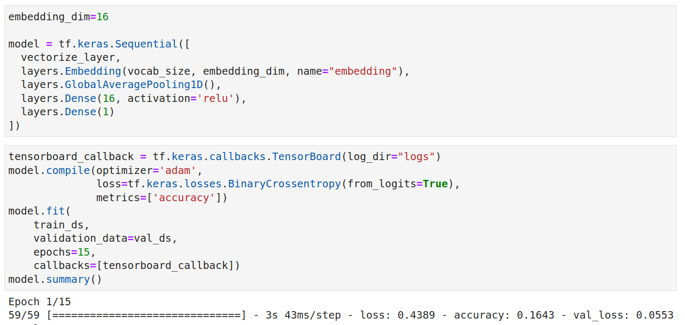
Text Vectorization

Slide 37
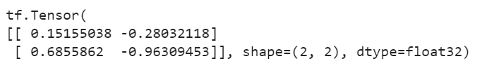
Sampling random tensors
The most common way is to sample each tensor entry from a random distribution. tf.random_normal allows you to sample each tensor entry with a specific shape from a normal distribution with a specific mean and standard deviation.
a = tf.random.normal((2, 2), mean=0, stddev=1)

Slide 38
Symmetry disturbance
Many machine learning algorithms learn by updating the set of tensors that support the weights. These update equations usually have the property that weights the initiated with the same value that will evolve together. So if the initial set of tensors is initialized with a fixed value, the model won't be able to learn. Correcting this situation requires a symmetry disorder. The easiest way to disturb symmetry is to randomly sample each entry in the tensor.

Slide 39
Symmetry disturbance
When sampling tens of millions of random values from the normal distribution, it becomes almost certain that some sampled values will be far from the mean. Such large samples can lead to numerical instability. It is common to sample with tf.truncated_normal() instead of tf.random_normal(). This function behaves the same as tf.random_normal() as far as the API is concerned. However it discards and resamples any values that exceed two standard deviations from the mean.

Slide 40
Types of tensors
You may have noticed dtype in the previous examples. There are various types of tensors in TensorFlow, such as: tf.float32, tf.float64, tf.int32, tf.int64. It is possible to create a specific type of tensor by setting the dtype argument in the tensor creation functions. In addition, for a given tensor, its type can be changed using conversion functions such as tf.to_double(), tf.to_float(), tf.to_int32(), tf.to_int64() and so forth.

Slide 41
Tensor broadcasting
Broadcasting is a term (as introduced by NumPy) used when matrices and vectors of a tensor system of different sizes can be added together. These rules allow for facilities such as adding a vector to each row of the matrix. Broadcasting rules can be quite complex, so we won't be going into a formal discussion on this topic. It is often easier to experiment and see for yourself how broadcast works.

Slide 42
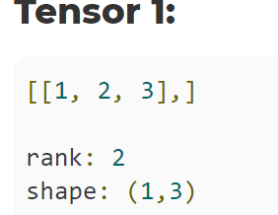
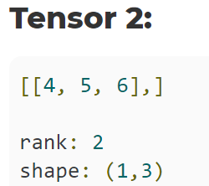
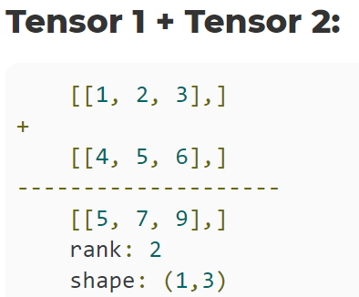
Tensor broadcasting - example no. 1 (the same shape)

Slide 43
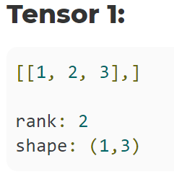
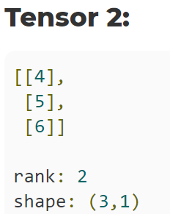
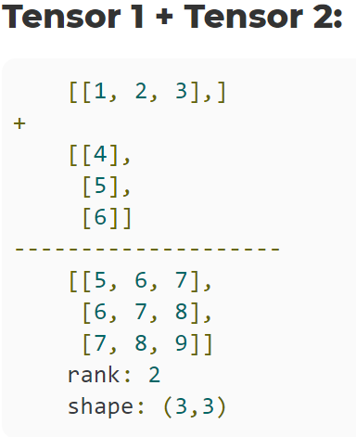
Tensor broadcasting - example no 2 (different shape but the same rank)

Slide 44
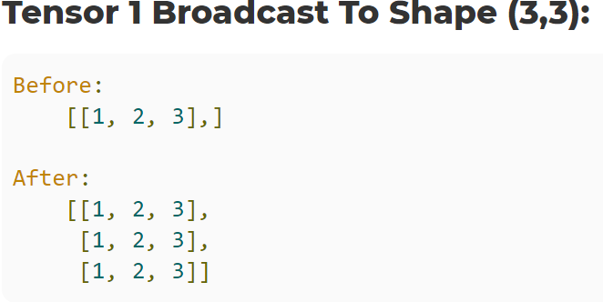
Broadcasting of tensor 1 to shape(3,3)

Slide 45
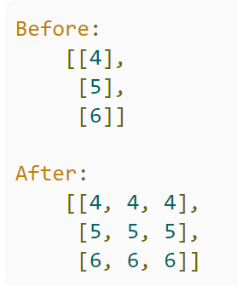
Broadcasting of tensor 2 to shape(3,3)

Slide 46
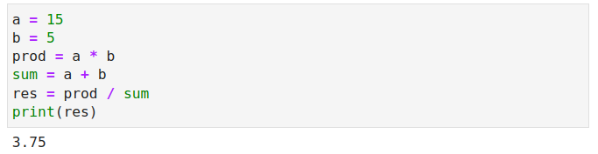
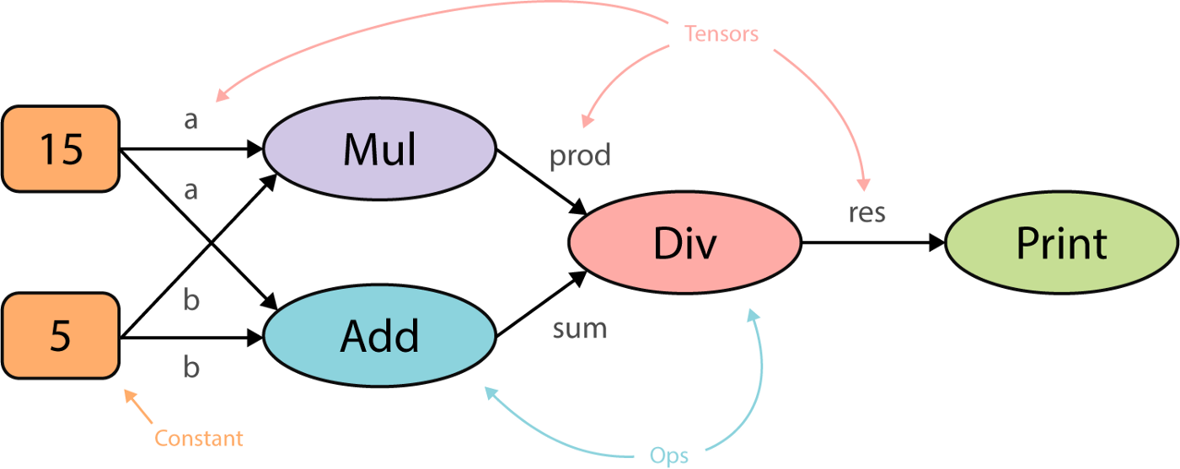
The calculation graph

Slide 47
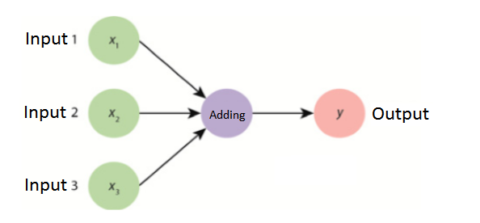
The calculation graph
The calculation graph is the basic unit of calculation in TensorFlow.
The model in TensorFlow contains a calculation graph.
In other words graphs are data structures that contain a set of tf.Operation objects which represent units of computation and tf.Tensor objects which represent the units of data that flow between operations.
tf.Graph - context of dataflow graph
Defining a calculation graph with 3 inputs (y = x1+x2+x3):

Slide 48
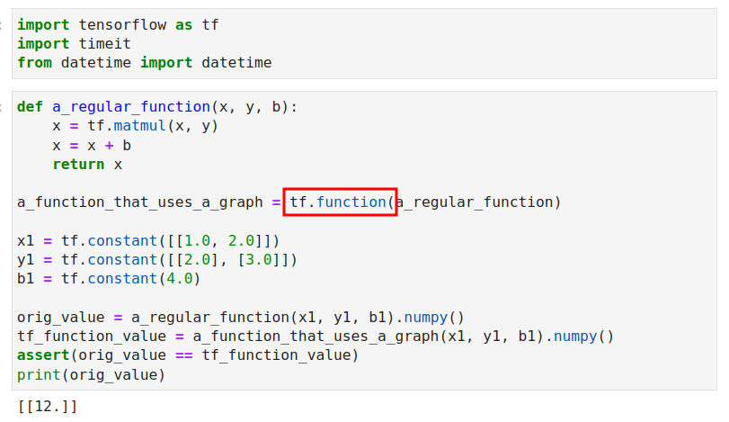
Calculation graph

Slide 49
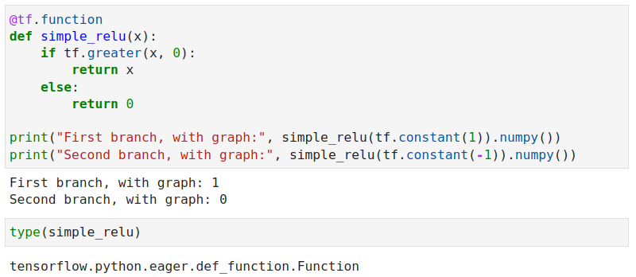
@tf.function

Slide 50
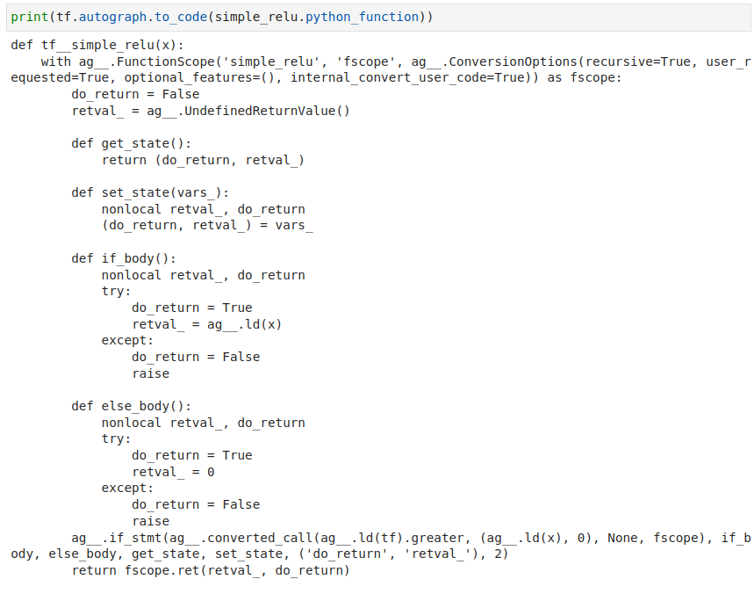
tf.autograph

Slide 51
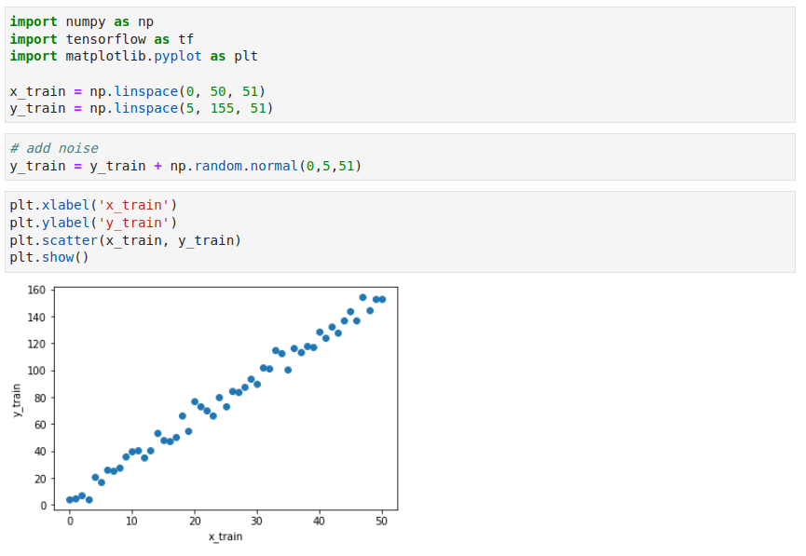
Linear Regression Sequential API

Slide 52
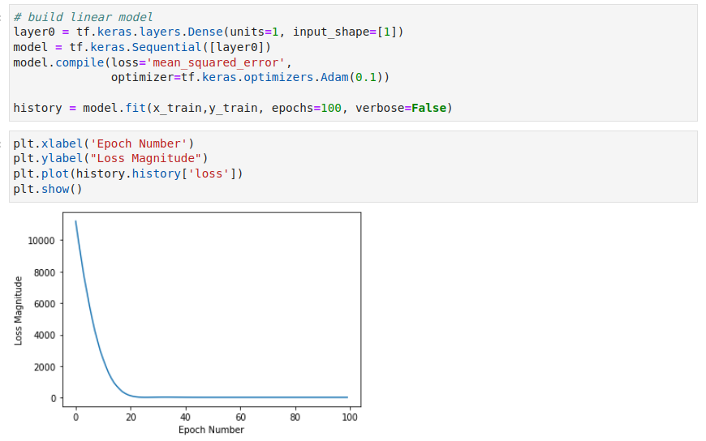
Linear Regression Sequential API

Slide 53
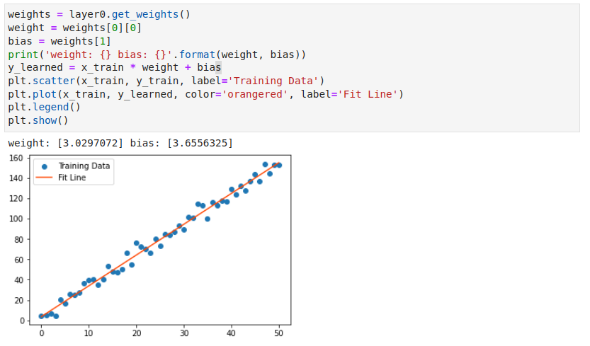
Linear Regression Sequential API

Slide 54
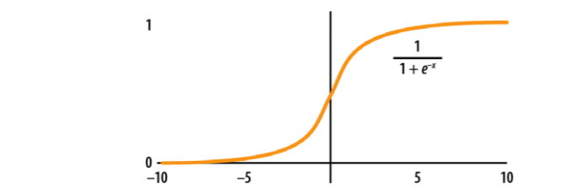
Logistic regression
It's worth considering what an equation for a classifier is. A common math trick is to use the sigmoid function. The sigmoid plotted in the figure below, commonly denoted by the symbol σ, is a function that transforms the real numbers ℝ to the range (0, 1). This property is useful because we can interpret the sigmoid output as the probability of an event (converting discrete events to continuous values is a recurring theme in machine learning).

Slide 55

Logistic Regression with MNIST

Slide 56

Logistic Regression with MNIST

Slide 57

Logistic Regression with MNIST

Slide 58

Logistic Regression with MNIST

Slide 59

Logistic Regression with MNIST

Slide 60

Fashion MNIST with Neural Network

Slide 61

Fashion MNIST with Neural Network

Slide 62

Explore Tensorboard

Slide 63

Tensorflow Lite
Advantages of using the tensorflow application on mobile devices:
Privacy — if training of the ML model can be performed on the device
Offline forecasting or classification
Development of smart devices
Machine Learning based systems can be more energy efficient
Use of data from the Internet of Things devices

Slide 64

The tensorflow lite architecture

Slide 65
Recommended materials related to the topic
https://www.tensorflow.org/guide
https://www.tensorflow.org/tutorials
https://www.tutorialspoint.com/tensorflow/index.htm
https://adventuresinmachinelearning.com/python-tensorflow-tutorial

